Slide 1


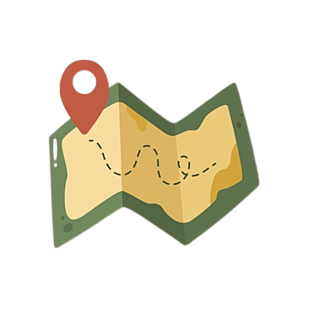


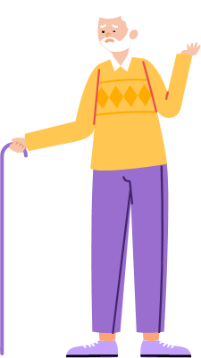




THIRD EYE A MOBILE APPLICATION FOR VISUALLY IMPAIRED PEOPLE TO ASSIST WITH DAILY TASKS 22_23-J 83
Supervisor – Ms. Uthpala Samarakoon
Co-Supervisor – Ms. Suriyaa Kumari
IT17088138 – M.C.J. Costa
IT19133614 – A.D. Amarasinghe
IT19103600 – K.D.J. Jayasekara
IT19981918 – A.M.N.D. Aththanayake

Slide 2

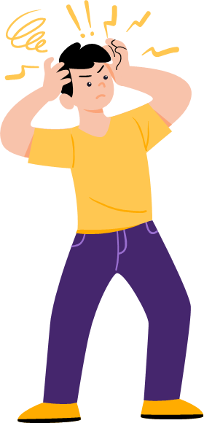

Research Problem
There’s no better product or software that can easily used by the visually impaired people to do their daily tasks easily.
• Limitations and problems in existing mobile applications
• Unaffordable high cost
• Security vulnerabilities and restrictions
• Don’t fulfil blind people requirements (navigation, objects recognitions, text reading)
• Evaluating color blindness type does not exist
• Real time support not existing
• Usability issues
03/02/2023

Slide 3



Objectives
Main Objective
Implement an application that can guide and assist blind people and visually troubled individuals. They can have support in which areas they have difficulties. Their difficulties can be overcome by this system which is fully automated with a built-in voice assistant and utilities that can support each of these said groups.
03/02/2023

Slide 4
Sub Objectives
Implement real time map navigation with a voice assistant support and suggestions to navigations where the distance can be reduced.
Implement real time text capturing and reading to assist blind users to understand languages. While weather forecasting can support when navigating through destination.
Implement object identifying when navigating through the journey to assist with obstacles, road signs as well as distances calculating to forecast collision detection.
Implement utilities where a colorblind user can minimize the difficulties they face when trying to identify color related elements for day-to-day activities. Support colorblind types by testing and evaluating which type of colorblindness is present and supporting throughout.
03/02/2023

Slide 5
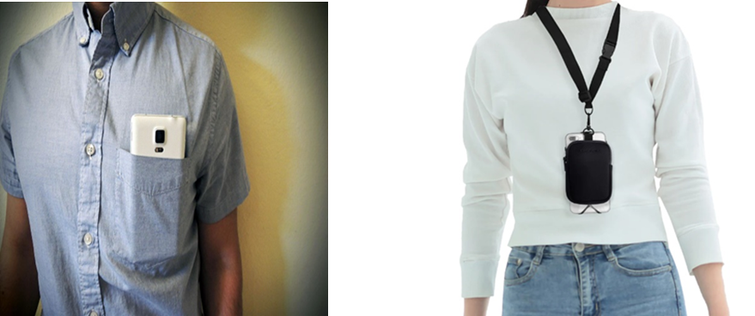
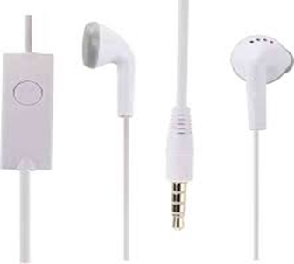
Hardware Solution
A camera is used to capture the visual data
Wireless/wired headphones are used to speak to the phone microphone to give voice commands
03/02/2023

Slide 6
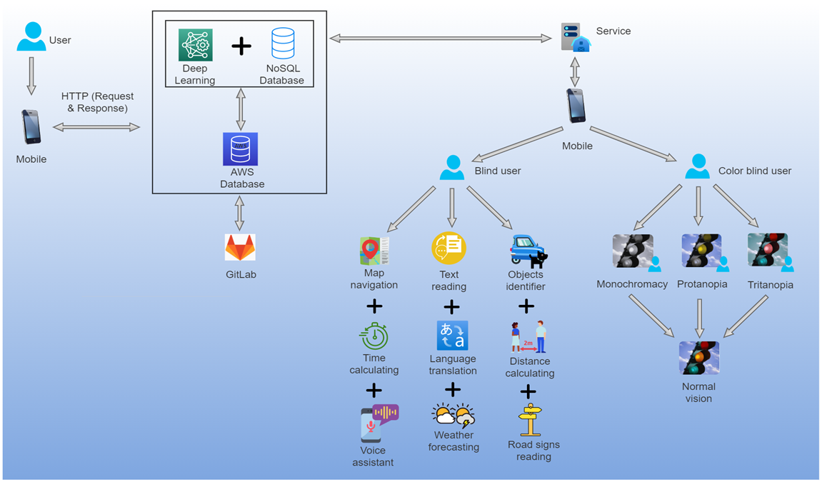
System Overview Diagram
03/02/2023

Slide 7
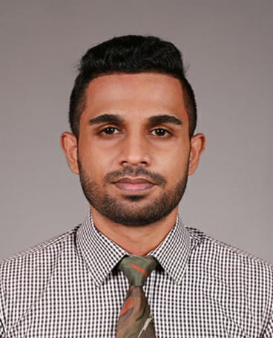
IT17088138 – M.C.J. Costa Information Technology
IT171088138 | M.C.J. Costa | 22_23-J 83
03/02/2023

Slide 8

Research Problem
Diagnosing a person what type of colorblindness they have
No current dataset supporting the users with correct color filter through the mobile device
Creating model to support Ishihara test
Create a mobile application to support the colorblind person
IT171088138 | M.C.J. Costa | 22_23-J 83
03/02/2023

Slide 9
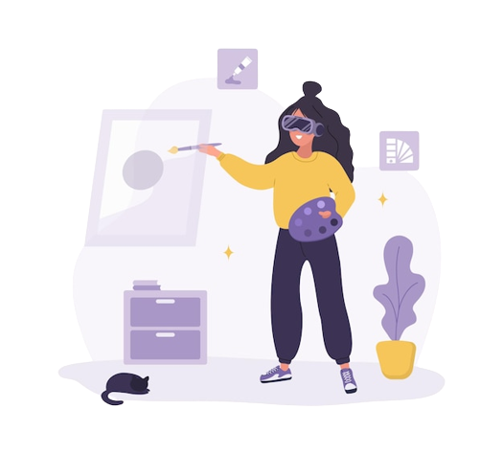

Proposed Solution
Implement real time augmented reality supported application which helps the colorblind people to get the QoL by using the smartphone accurately.
To evaluate the type of colorblindness, create “Ishihara” tests
Add a display filter depending on the evaluated result
Guide user with Augmented Reality
IT171088138 | M.C.J. Costa | 22_23-J 83
03/02/2023

Slide 10
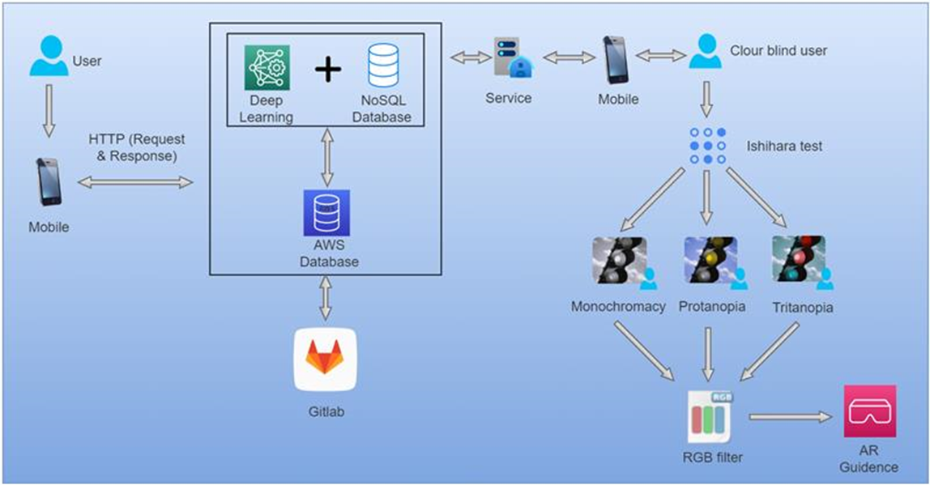
Component Overview Diagram
IT171088138 | M.C.J. Costa | 22_23-J 83
03/02/2023

Slide 11

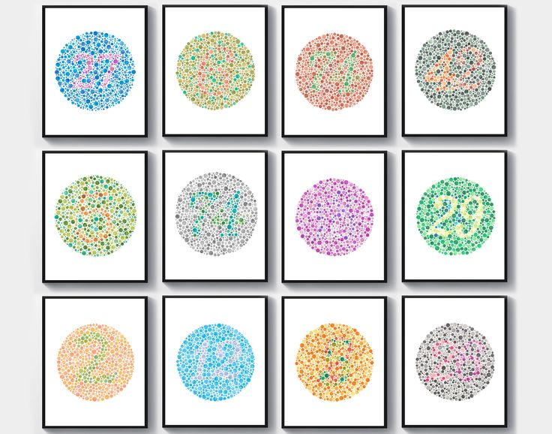
Current Progress 50%
Collected Ishihara diagnostics plates and data.
Implemented a dataset using a gathered dataset.
Training the dataset using the gathered set.
Created a custom model to identify different type of colorblind diagnosis.
Developing a custom script to get the user input to finalize the color blindness conditions.
IT171088138 | M.C.J. Costa | 22_23-J 83
03/02/2023

Slide 12
Requirements
User Requirements
It is desirable that the app could manage multiple object description through AR.
System Requirements
Smartphone should have at least a 20MP back camera which all modern smartphone have these days.
Non-Functional Requirements
Availability
The app should provide real-time information without any latency.
Android version 8 or above.
iOS version 11 or above.
Reliability
Usability
The user must take the test to determine the type of colorblindness.
IT171088138 | M.C.J. Costa | 22_23-J 83
03/02/2023

Slide 13
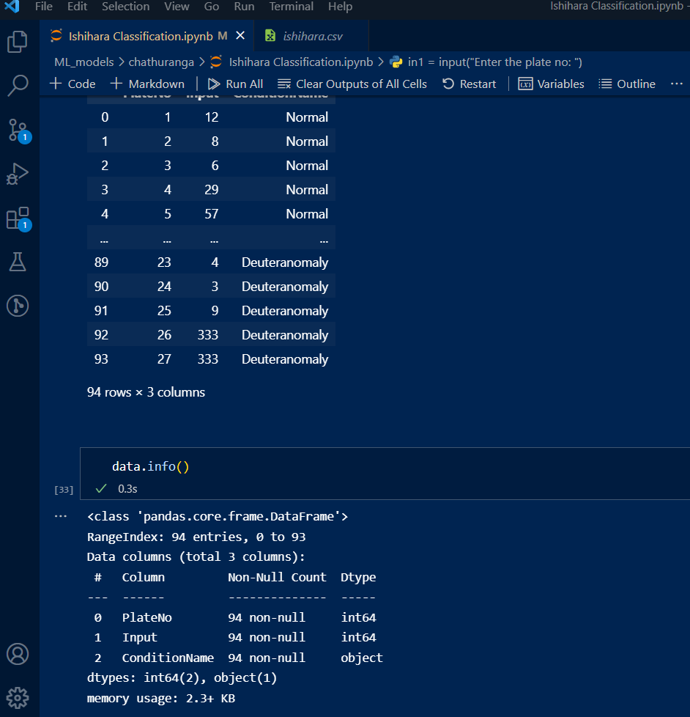
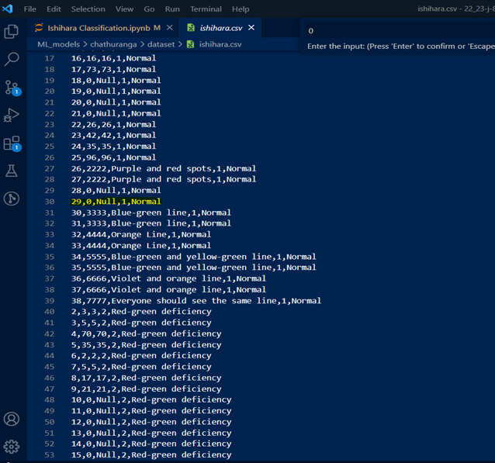
Proof Of Work
IT171088138 | M.C.J. Costa | 22_23-J 83
03/02/2023

Slide 14
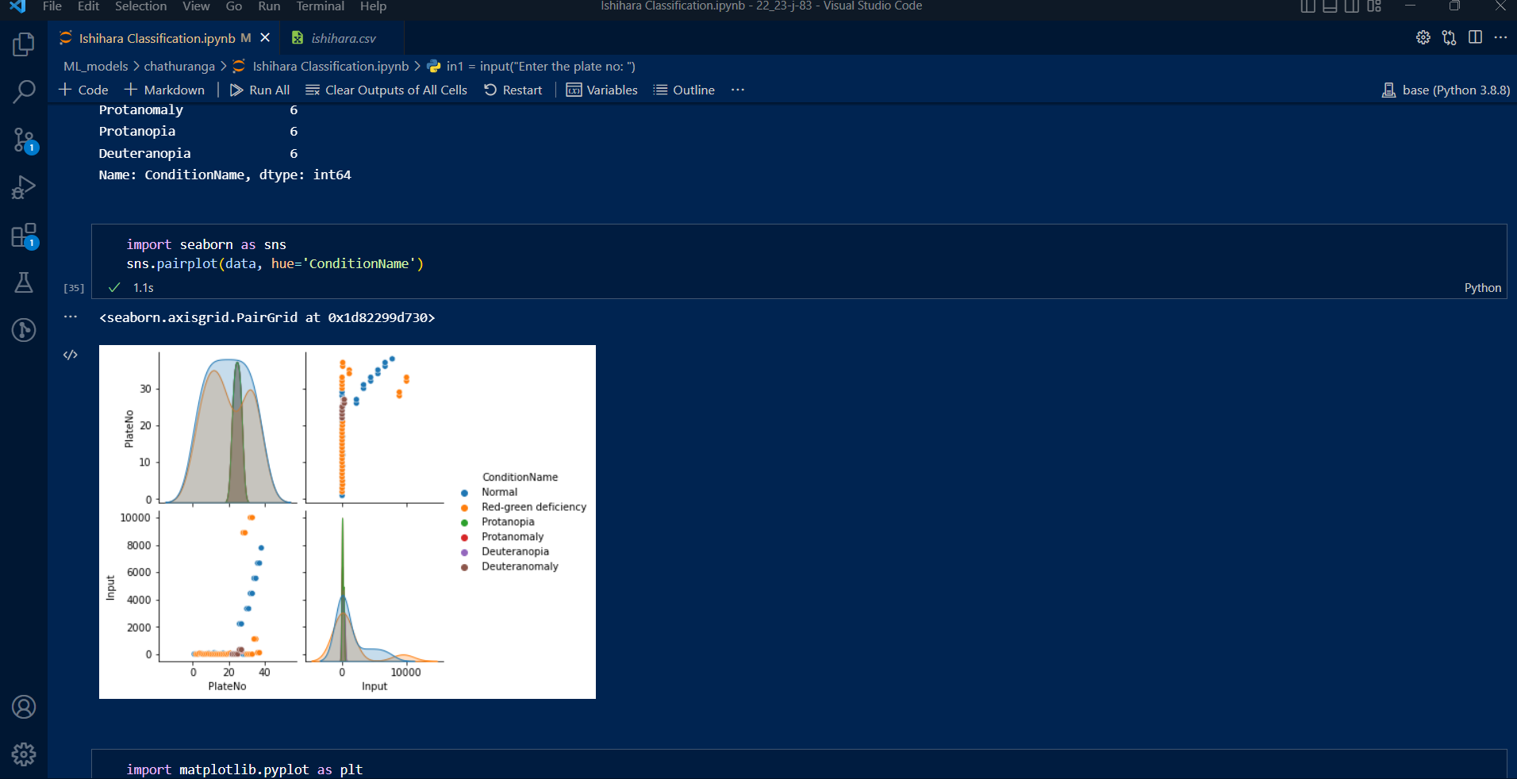
Proof Of Work
IT171088138 | M.C.J. Costa | 22_23-J 83
03/02/2023

Slide 15
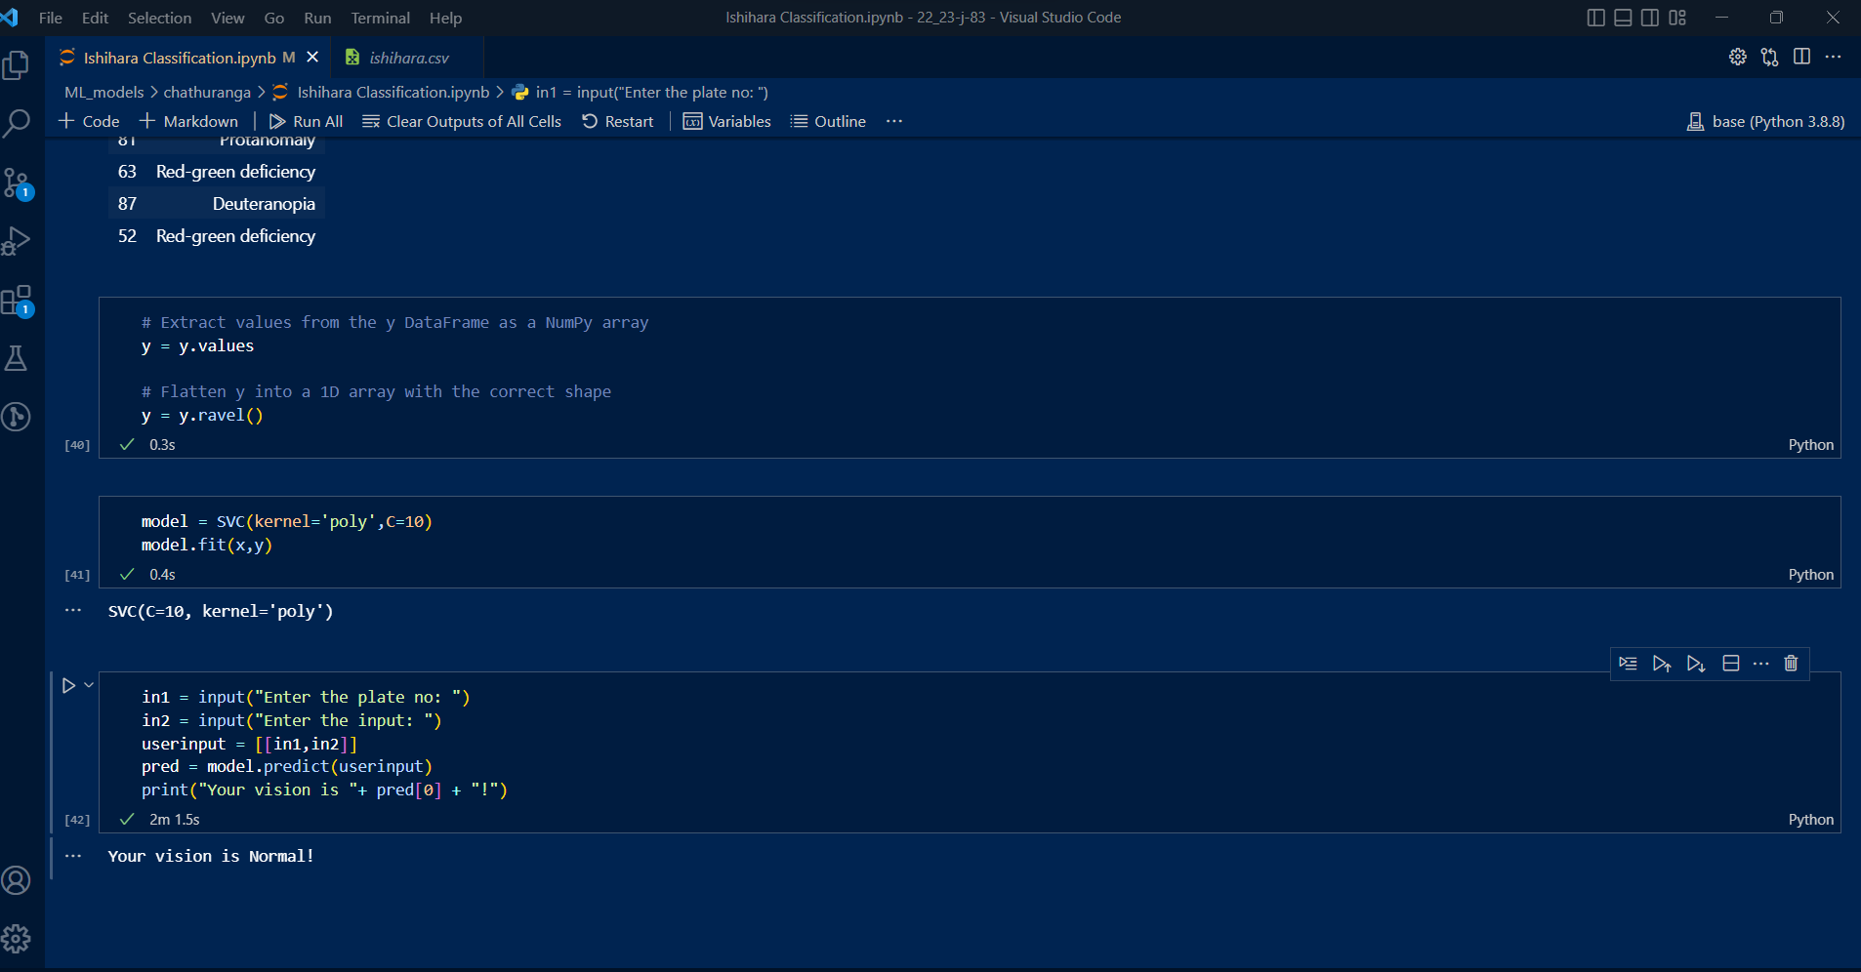
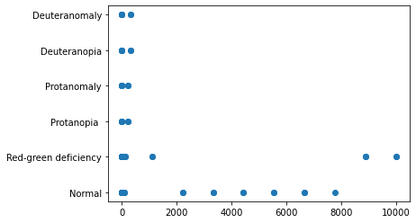
Proof Of Work
IT171088138 | M.C.J. Costa | 22_23-J 83
03/02/2023

Slide 16

Next Expected Progress 100%
Create and develop the model in cloud to use it anywhere with a lesser number of performance lag.
Create a mobile application with UI to handle the Ishihara test.
Use the test results to implement a custom filters for user’s mobile.
IT171088138 | M.C.J. Costa | 22_23-J 83
03/02/2023

Slide 17

Risk Mitigation
Create a custom data set because no current data set
Training the model to display Ishihara test results with user’s inputs
When training the model, the number of Ishihara plates were not significant enough to get a accurate prediction for some color blindness types
When training the machine learning model what type of model needs to be considered (classification)
Choosing between support vector classification and binary classification to get the accurate prediction
IT171088138 | M.C.J. Costa | 22_23-J 83
03/02/2023

Slide 18




Tools & Technologies
Support Vector Machine Algorithm
Jupyter notebook
Anaconda environment
IT171088138 | M.C.J. Costa | 22_23-J 83
03/02/2023

Slide 19
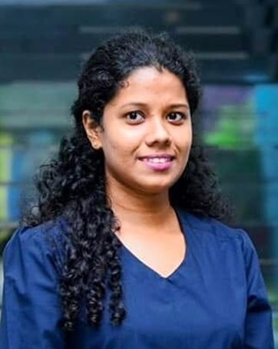
IT19133614 – A.D. Amarasinghe Information Technology
IT19133614 | A.D. Amarasinghe | 22_23-J 83
03/02/2023

Slide 20

Research Problem
There’s no proper mobile application for visually impaired people to help with both indoor and outdoor navigation. And also, BVI people prefer voice-command-based applications rather than finger taps to accomplish their needs.
IT19133614 | A.D. Amarasinghe | 22_23-J 83
03/02/2023

Slide 21
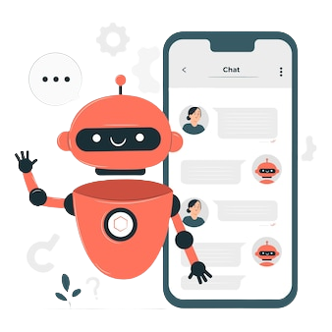
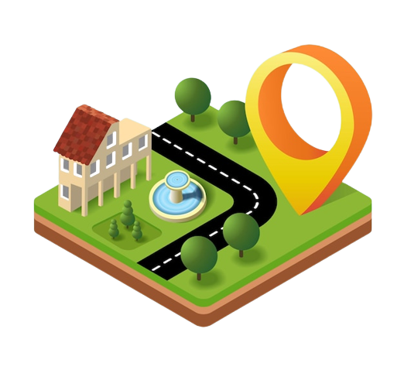

Proposed Solution
Implement real time map navigation with a voice assistant support and suggestions to navigations where the distance can be reduced.
Implementation of the voice assistant to be effective, clear, and accurate when it guides the user.
Accurate map navigation for both indoor and outdoor even offline.
Suggest similar destinations and calculate the time to reach the destination.
IT19133614 | A.D. Amarasinghe | 22_23-J 83
03/02/2023

Slide 22
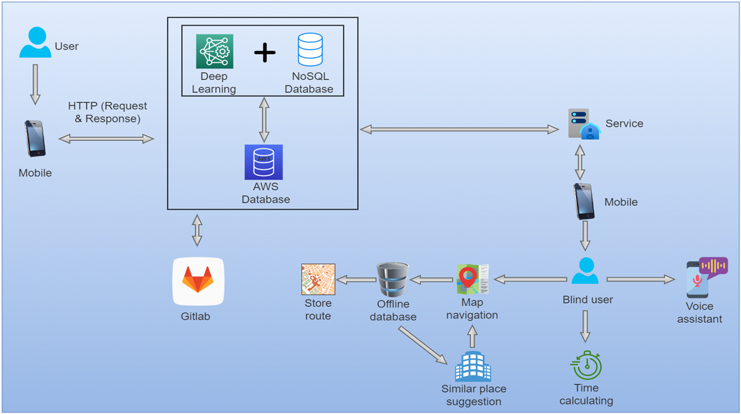
Component Overview Diagram
IT19133614 | A.D. Amarasinghe | 22_23-J 83
03/02/2023

Slide 23
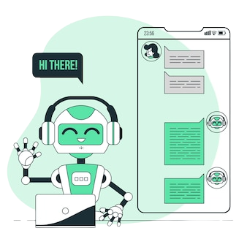
Current Progress 50%
Implemented an intelligent chatbot using Long Short-Term Memory (LSTM) deep neural network algorithm which can give random responses for trained questions.
Created a dataset in ‘JSON’ format defining different requests and responses from server to client and vice versa.
Created and develop the model in cloud to use it anywhere to reduce the performance lag.
IT19133614 | A.D. Amarasinghe | 22_23-J 83
03/02/2023

Slide 24
Requirements
User Requirements
System Requirements
In general, however, other applications (including the voice assistant) should be able to run in parallel with the navigation app.
Non-Functional Requirements
Availability
The app should be capable to assist the BVI throughout routes that combine both indoor and outdoor navigation.
The voice assistant should be able to accomplish user needs as much as possible and accurately.
The app should be capable to detect a wrong route and to correct or adjust it accordingly.
GPS should be discreet and not too obvious.
Accuracy
Speed
Usability
IT19133614 | A.D. Amarasinghe | 22_23-J 83
03/02/2023

Slide 25
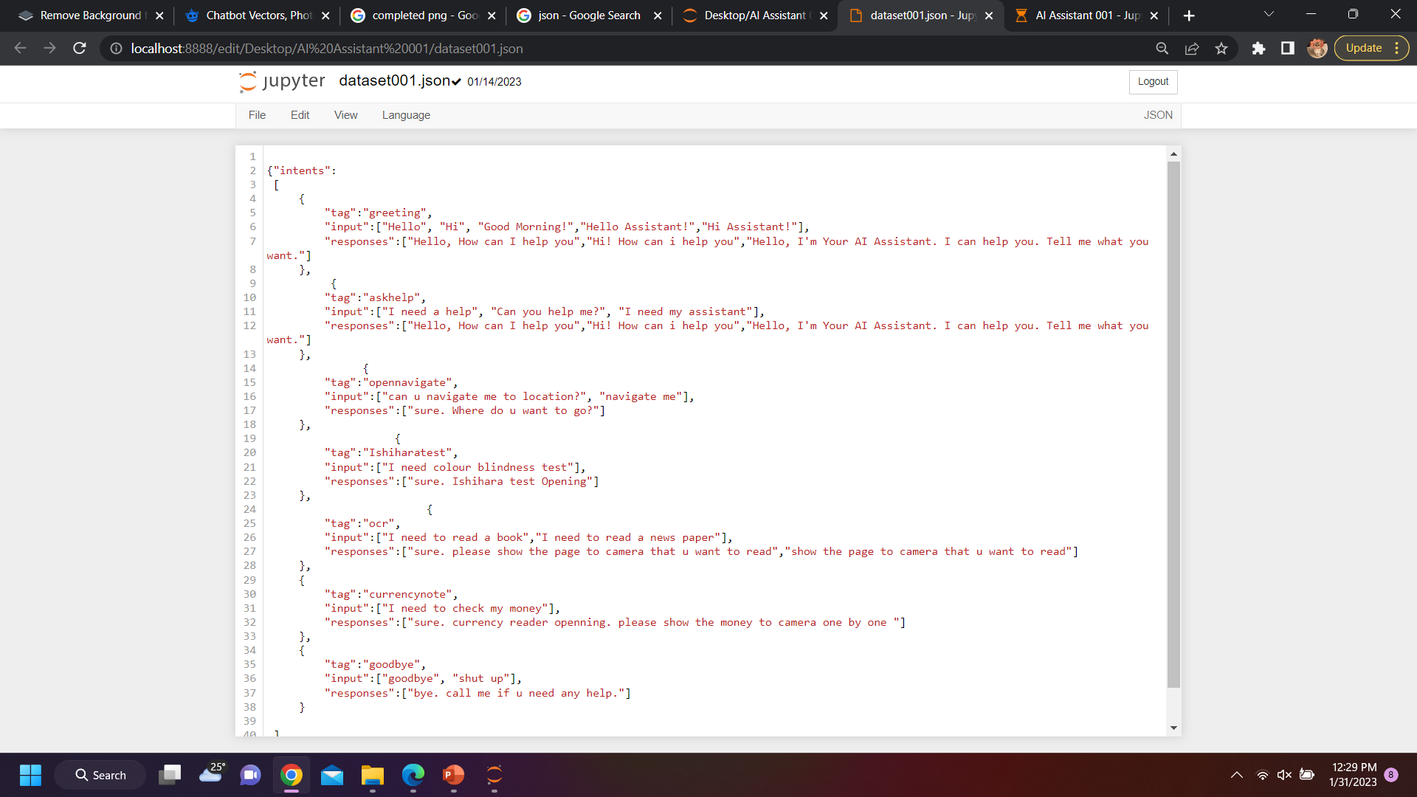
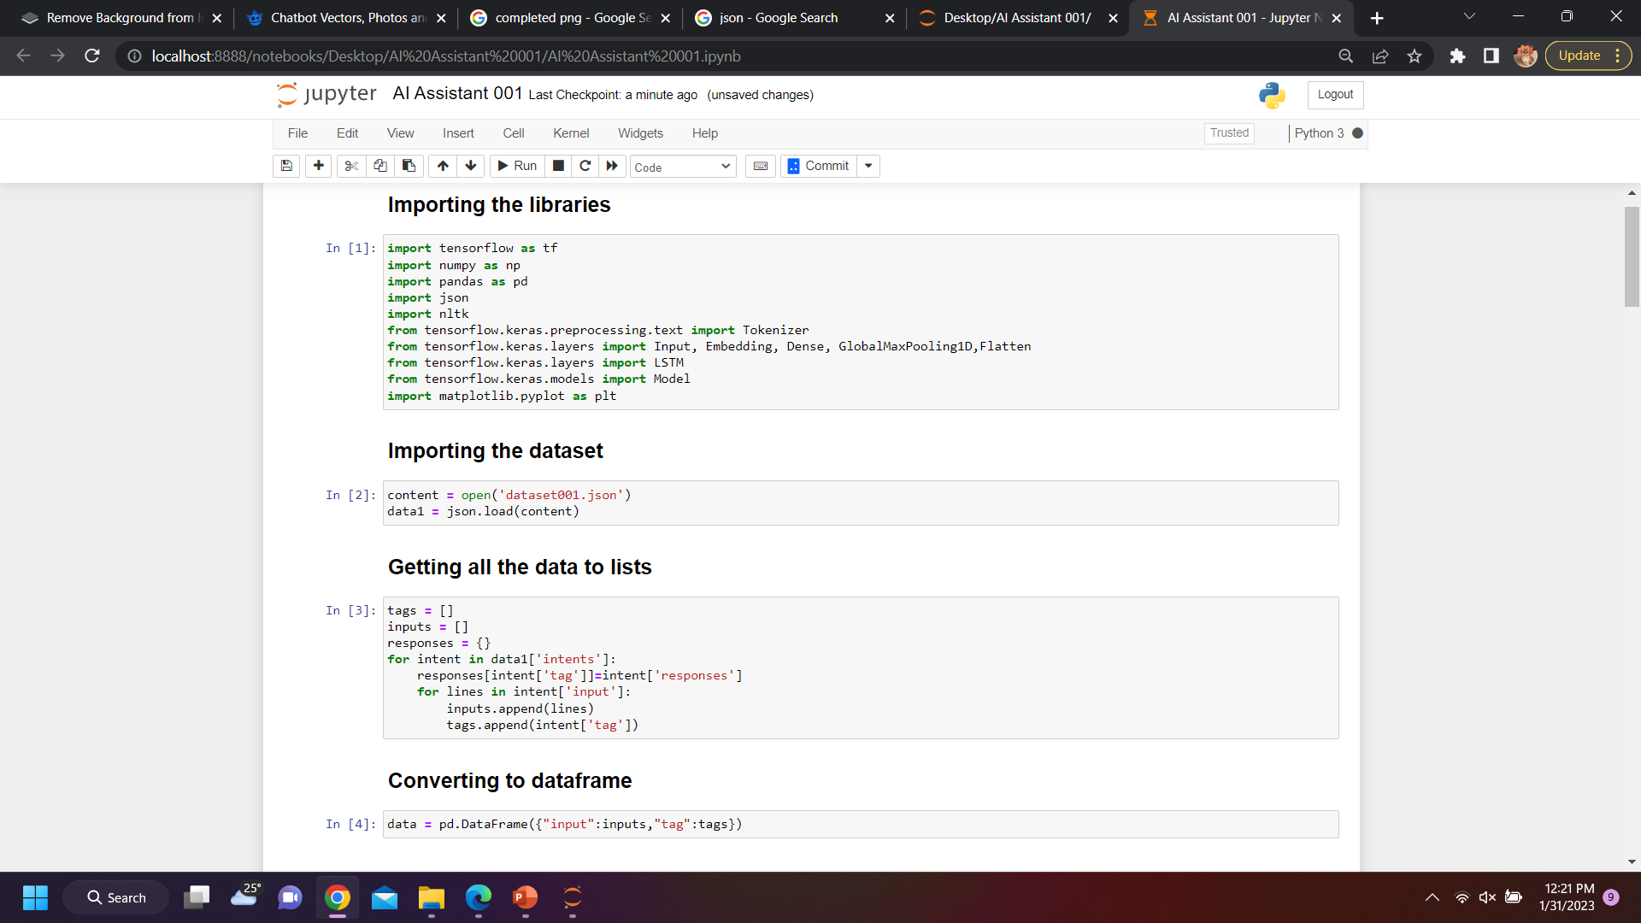
Proof Of Work
IT19133614 | A.D. Amarasinghe | 22_23-J 83
03/02/2023

Slide 26
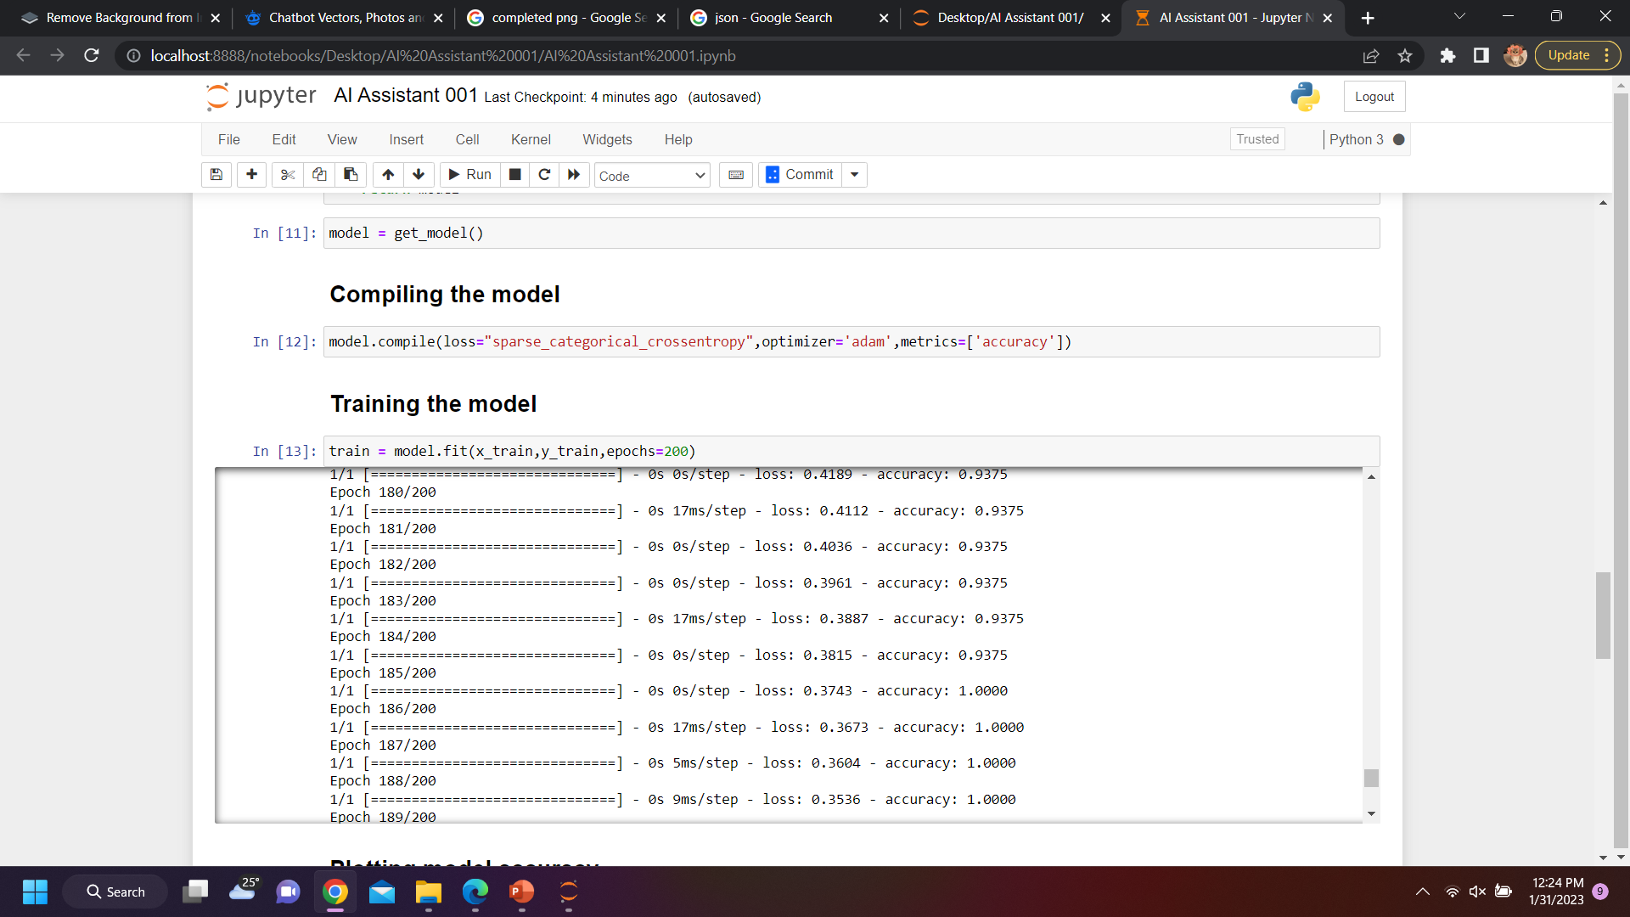
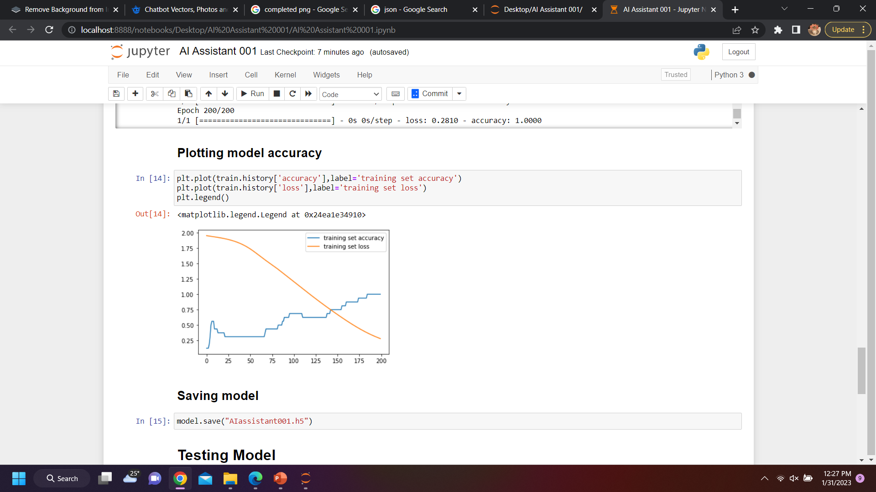
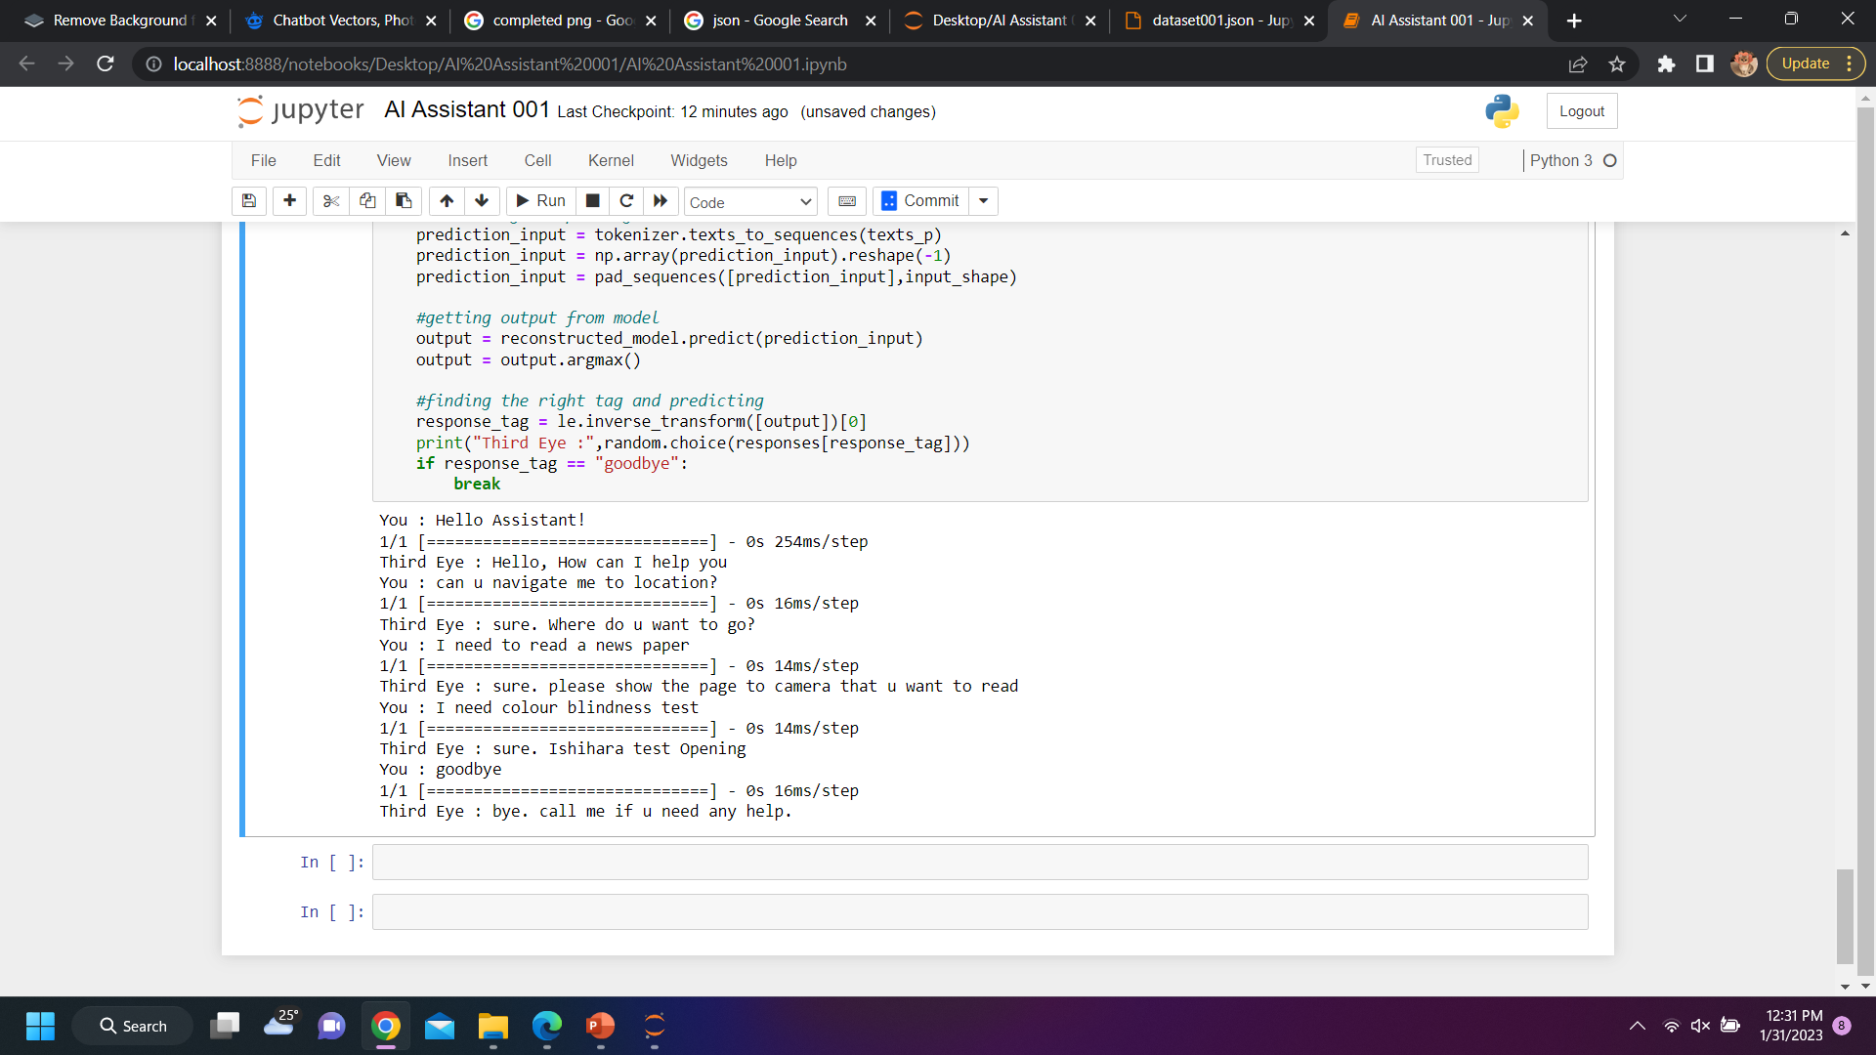
Proof Of Work
IT19133614 | A.D. Amarasinghe | 22_23-J 83
03/02/2023

Slide 27
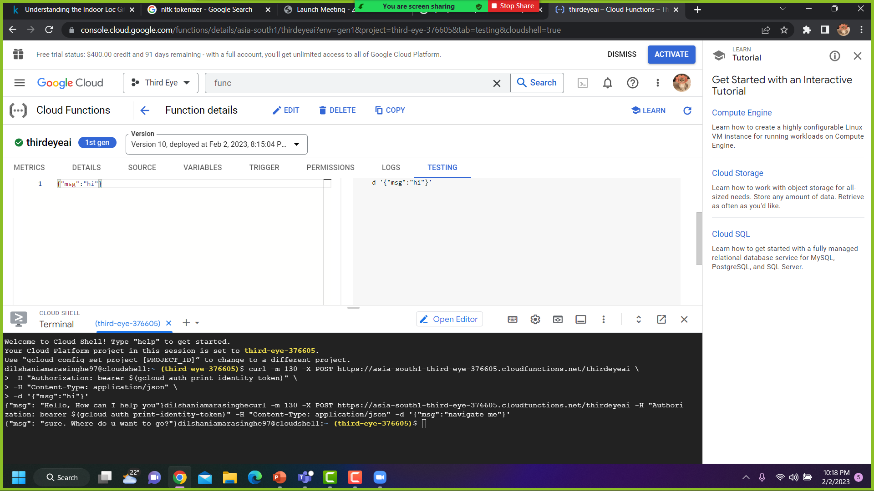
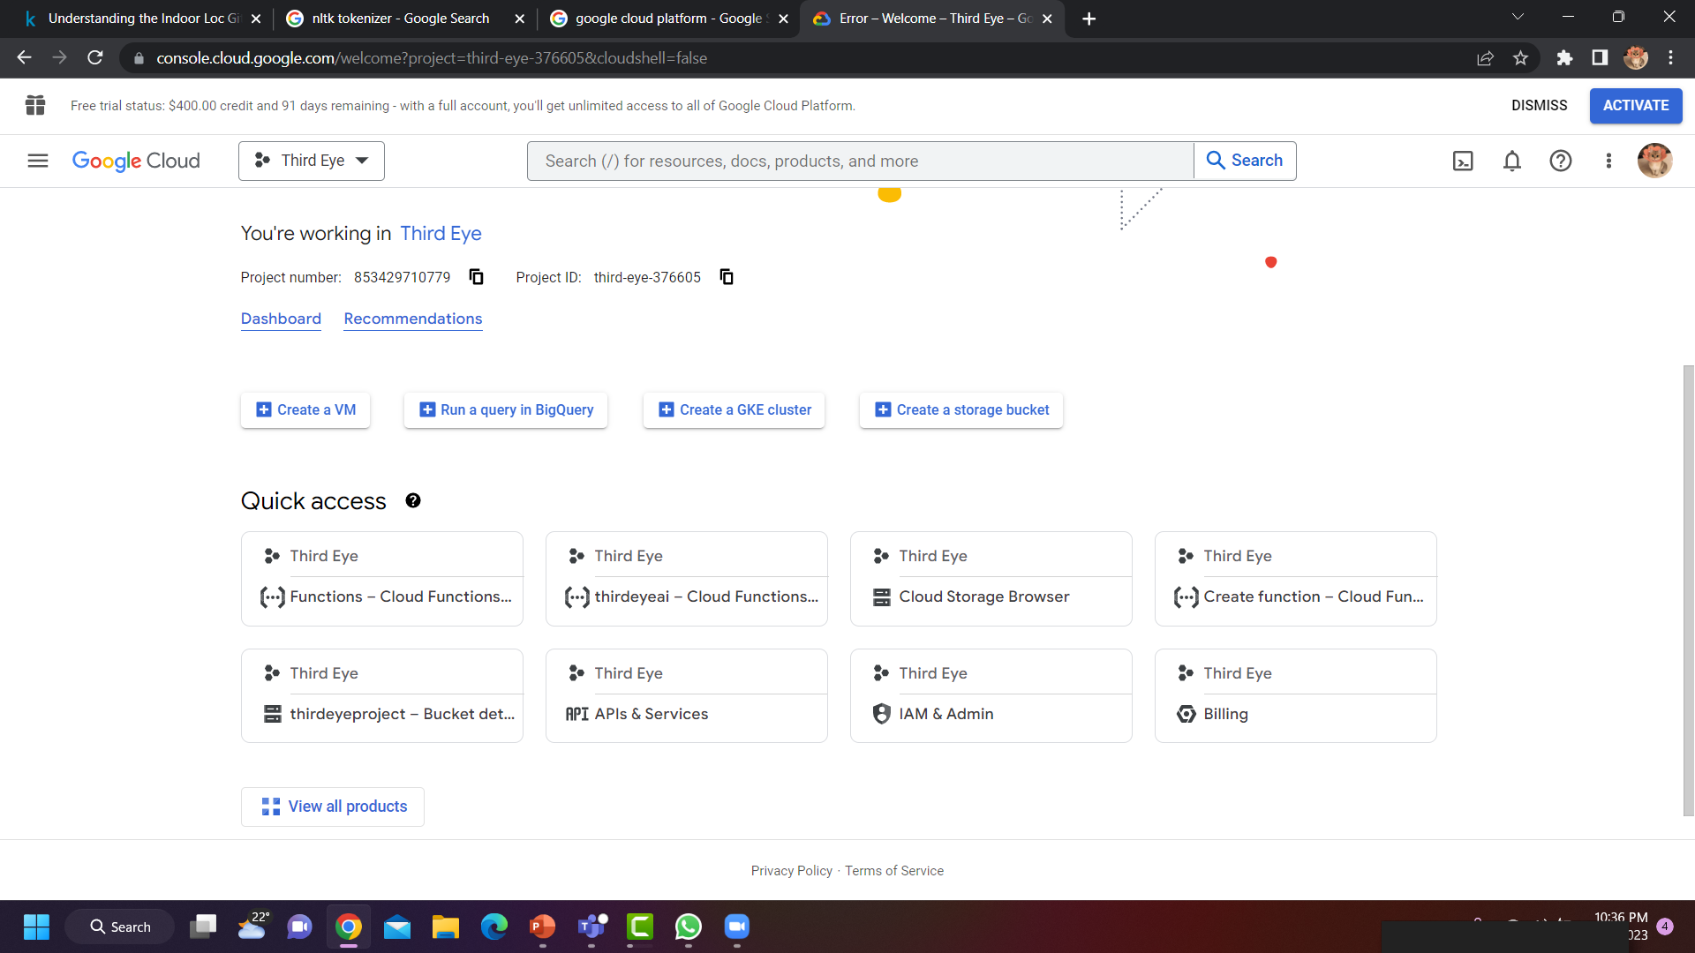
Proof Of Work
IT19133614 | A.D. Amarasinghe | 22_23-J 83
03/02/2023

Slide 28
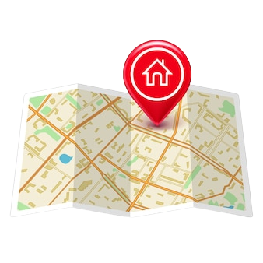
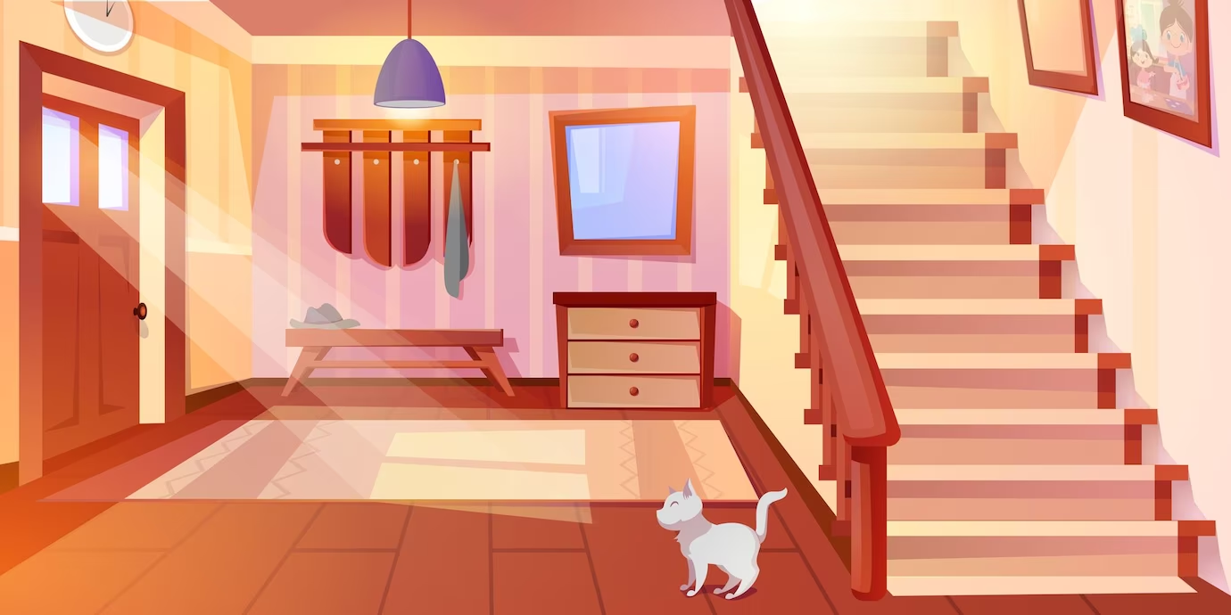
Next Expected Progress 100%
Implement the android mobile application to properly work the text to speech function of the implemented chatbot.
Implement the outdoor navigation function with the AI assistant’s support using GPS based map.
Implement the connectivity between the chatbot and object detection function to work the indoor navigation functionality.
IT19133614 | A.D. Amarasinghe | 22_23-J 83
03/02/2023

Slide 29

Risk Mitigation
Indoor navigation is impossible to do practically because of the signal block, and weakness in indoor areas.
And, without entering a floor plan or a blueprint to the system, an application can’t navigate the user to a destination.
Augmented Reality based options give a partial solution, but it is useless to a blind person because he can’t see the directions displaying in the screen.
IT19133614 | A.D. Amarasinghe | 22_23-J 83
03/02/2023

Slide 30
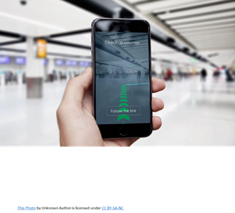
Risk Mitigation
The solution is to combine both voice assistant and object detection functions together to do the indoor navigation.
Because object identifier detect vary range of obstacles in user’s walking path.
IT19133614 | A.D. Amarasinghe | 22_23-J 83
03/02/2023

Slide 31
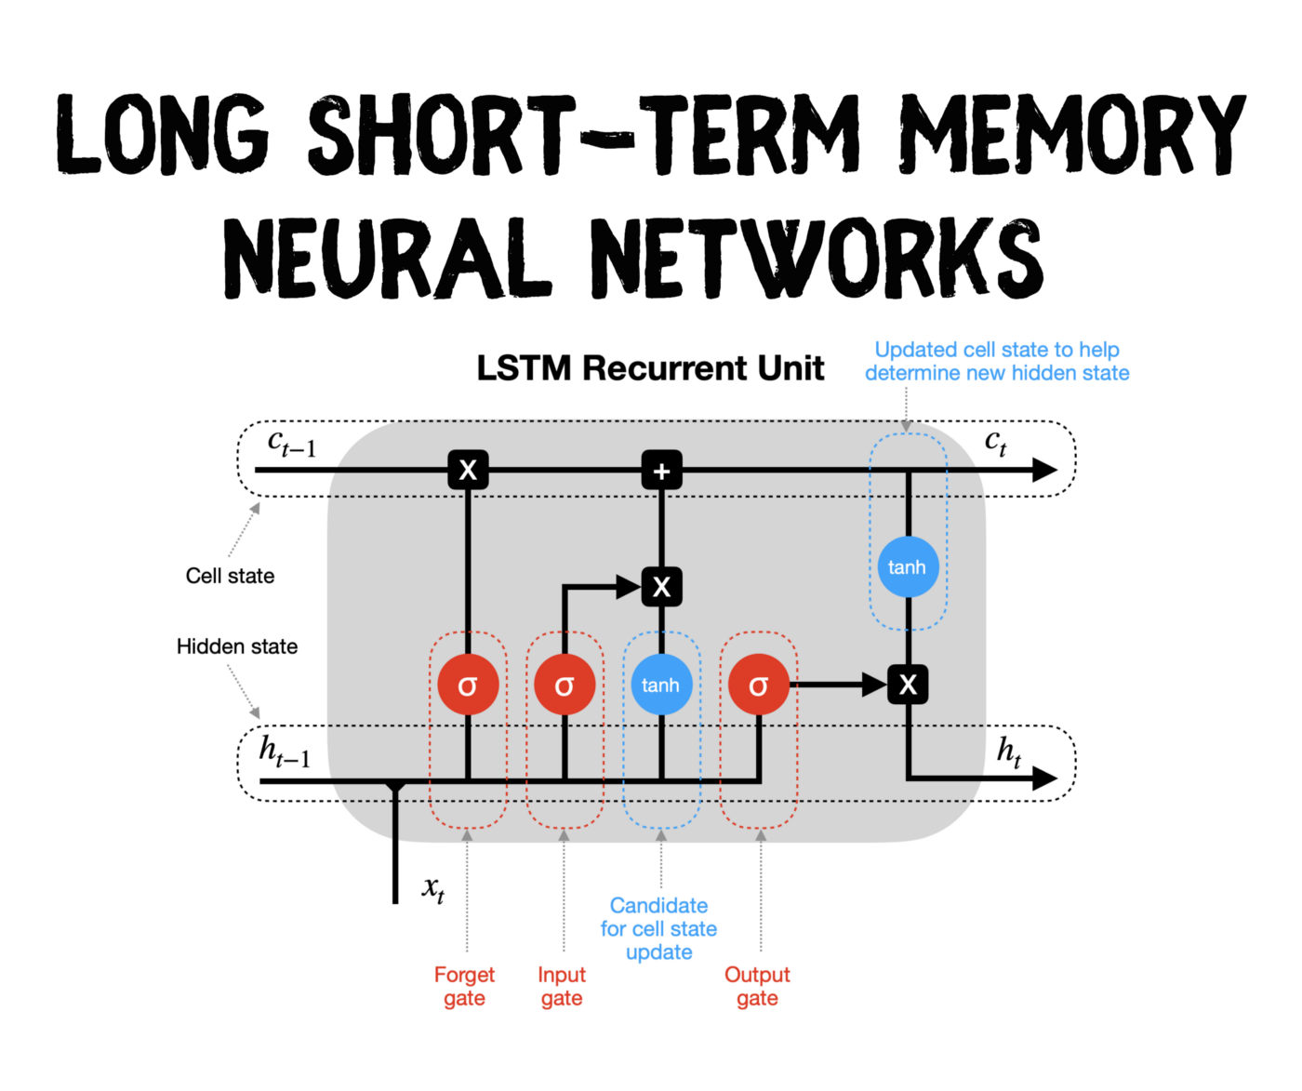


Tools & Technologies
LSTM neural network
Jupyter notebook
Anaconda environment
NLTK tokenizer
Json
Google Cloud
IT19133614 | A.D. Amarasinghe | 22_23-J 83
03/02/2023

Slide 32
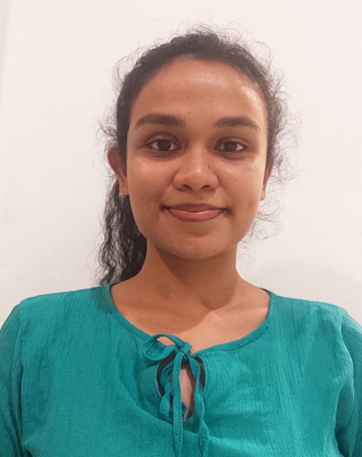
IT19103600 – K.D.J. Jayasekara Information Technology
IT19103600 | K.D.J. Jayasekara | 22_23-J 83
03/02/2023

Slide 33

Research Problem
Aiding visually impaired people to identifying currency notes and coins accurately Realtime
Training a machine learning to identify the accurate outcome
Creating a mobile application to support user how it should be delivered
IT19103600 | K.D.J. Jayasekara | 22_23-J 83
03/02/2023

Slide 34
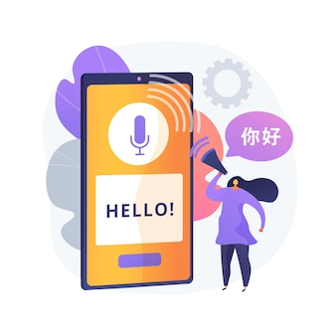

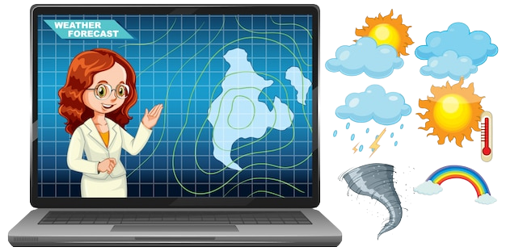

Proposed Solution
Implement real time mobile application to be assistive for blind people implementing a text reader, weather predictor.
Implementing a currency notes and coins identifier.
A reliable and accurate weather forecasting system.
Implementing real time text reading and translating functionalities.
IT19103600 | K.D.J. Jayasekara | 22_23-J 83
03/02/2023

Slide 35
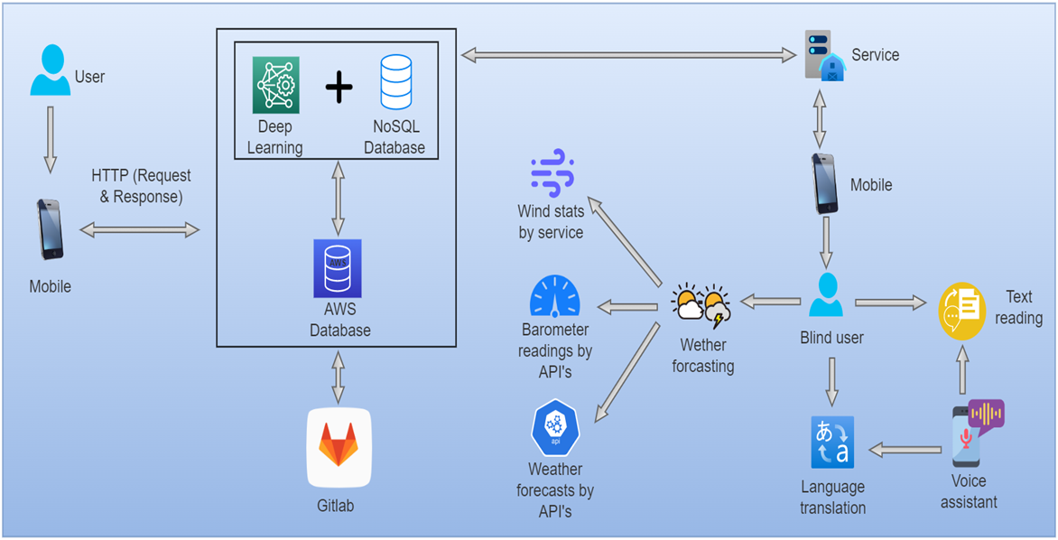
Component Overview Diagram
IT19103600 | K.D.J. Jayasekara | 22_23-J 83
03/02/2023

Slide 36
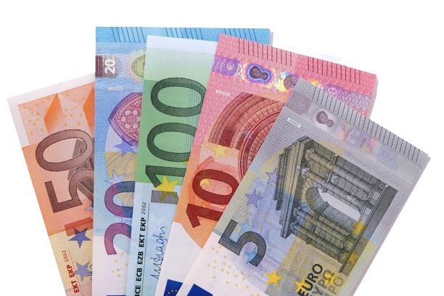
Current Progress 50%
Collecting coins and notes images with different angles for each note and coin to be later be used as the trained-test split in the model.
Training a model to identify currency with the given sample of test images
Custom YOLOV5 model which uses compound detection model to train the custom data set to identify given notes and coins in Real time
Using YOLOV5 framework to identify objects which captures objects real time and train the model to give a prediction
Training the model until it gives an accurate prediction.
IT19103600 | K.D.J. Jayasekara | 22_23-J 83
03/02/2023

Slide 37
Requirements
User Requirements
The app should provide real-time information without any latency.
System Requirements
Smartphone should have at least a 20MP back camera which all modern smartphone have these days.
The application should be easily handled by the user.
Proposed mobile application should work on both Android and iOS mobile operating systems.
Non-Functional Requirements
Availability
Accuracy
Speed
IT19103600 | K.D.J. Jayasekara | 22_23-J 83
03/02/2023

Slide 38
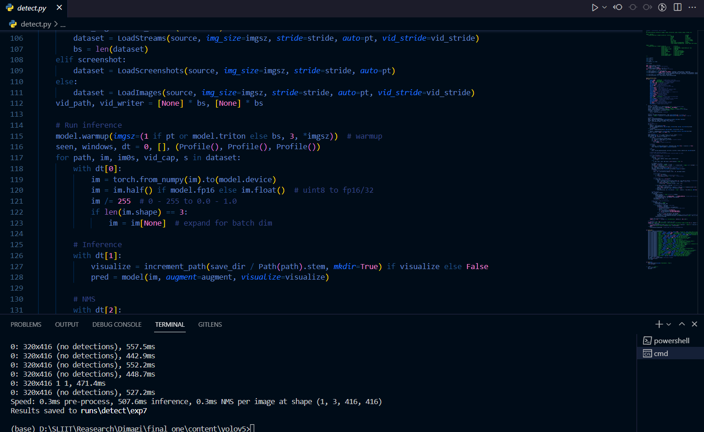
Proof Of Work
IT19103600 | K.D.J. Jayasekara | 22_23-J 83
03/02/2023

Slide 39
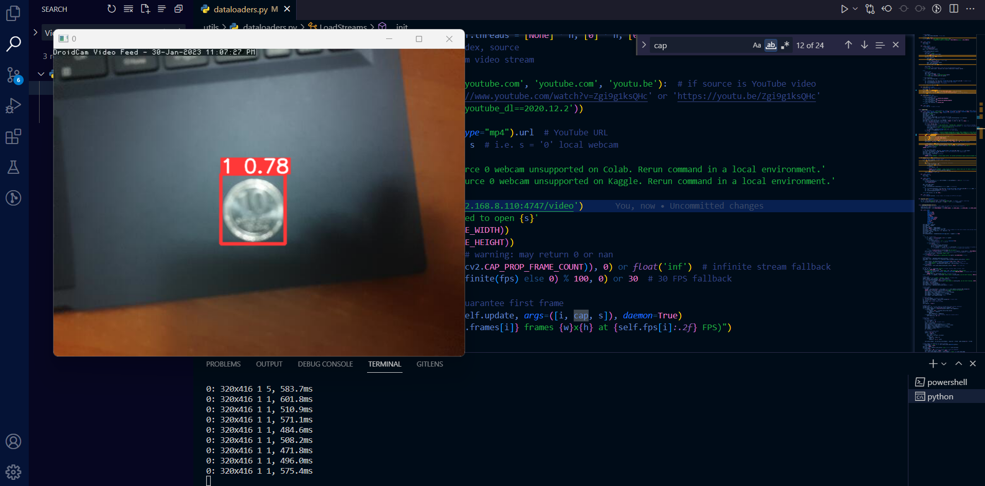
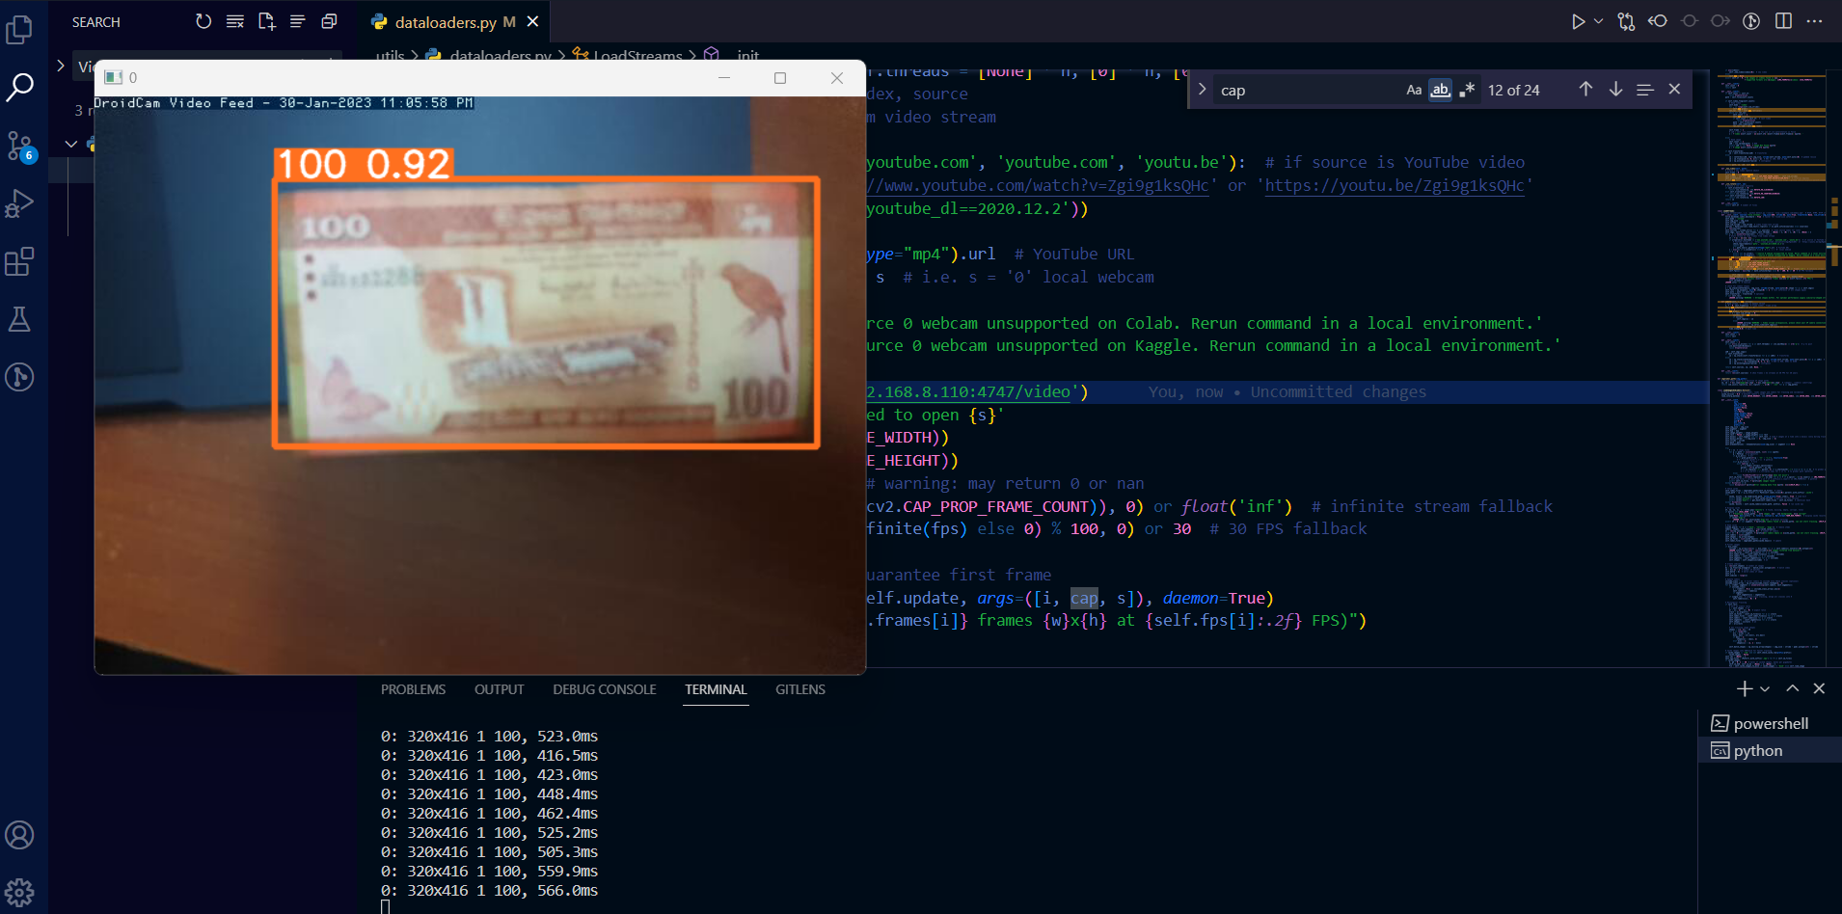
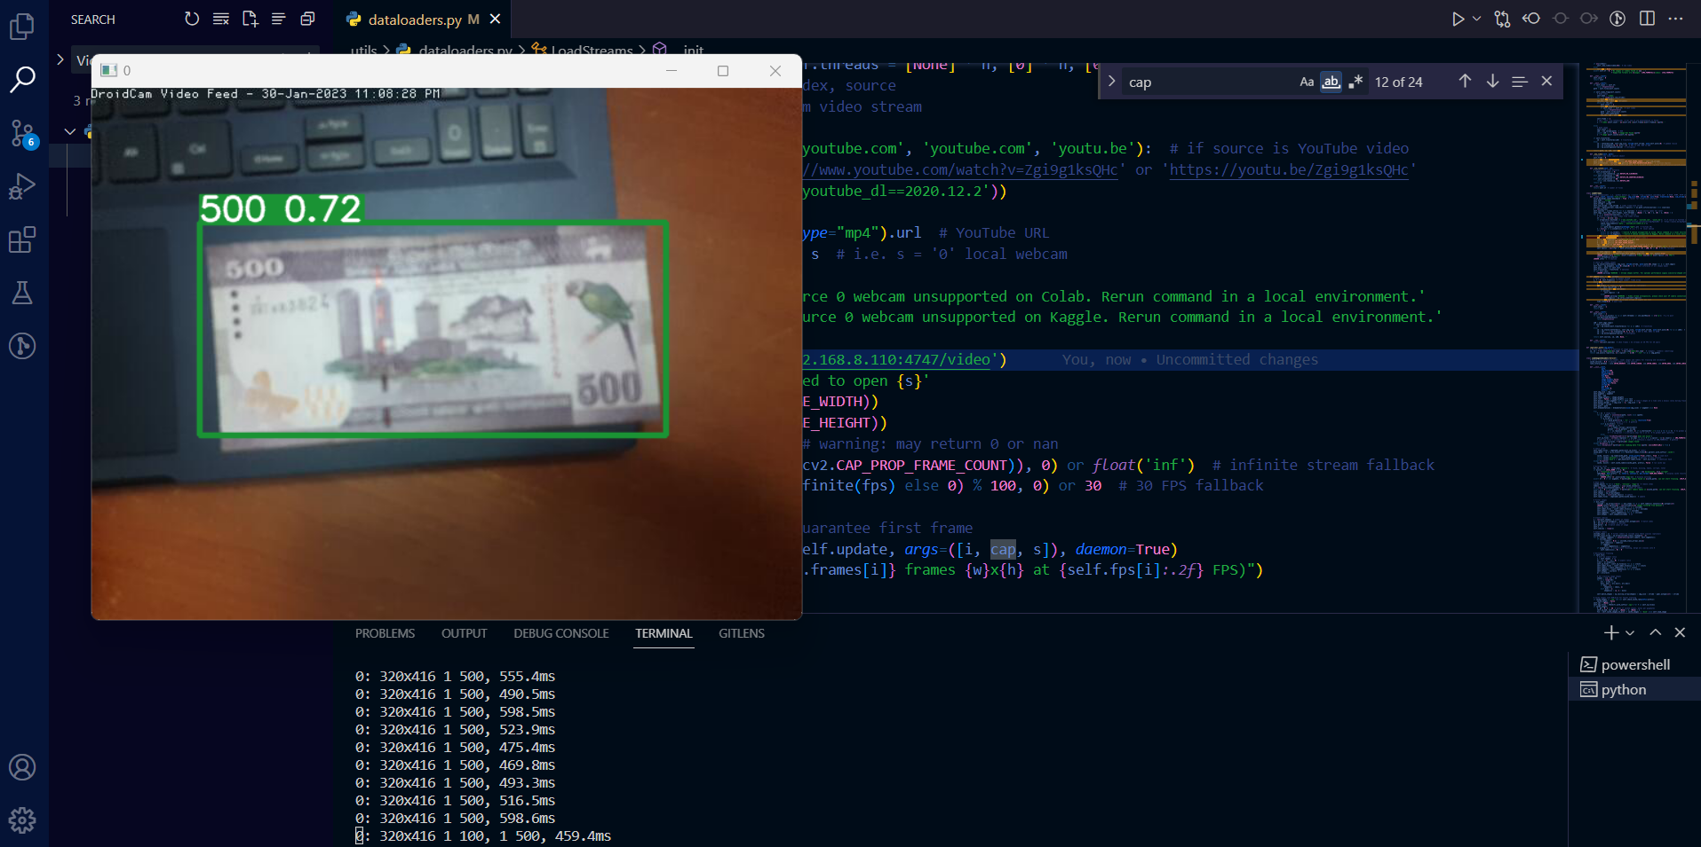
Proof Of Work
IT19103600 | K.D.J. Jayasekara | 22_23-J 83
03/02/2023

Slide 40
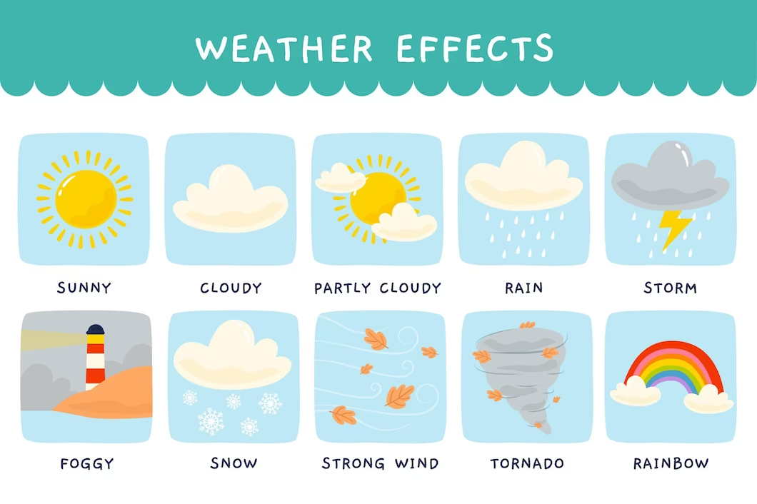
Next Expected Progress 100%
Implementing an OCR to identify texts
Implementing a mechanism to identify weather changes
Using TensorFlow light and implementing the model to a mobile application
Implement all functions together to a single reliable and an accurate mobile application
IT19103600 | K.D.J. Jayasekara | 22_23-J 83
03/02/2023

Slide 41
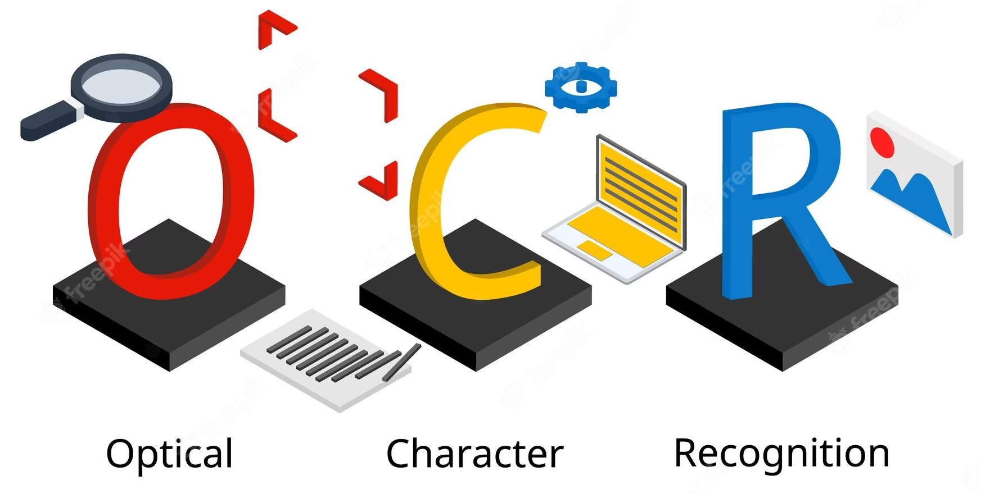



Tools & Technologies
YOLO4
Transfer Learning
Multi class object detection
Optical Character Recognizer
IT19103600 | K.D.J. Jayasekara | 22_23-J 83
03/02/2023

Slide 42


Risk Mitigation
To implement considering which ML method to get results when identifying currency notes
Using YOLOV4 training model with custom made data set of images
Using YOLOV5 instead of YOLOV4 to enhance performs
Inaccurate coin identification, therefore expanding data set and different model for coins
IT19103600 | K.D.J. Jayasekara | 22_23-J 83
03/02/2023

Slide 43
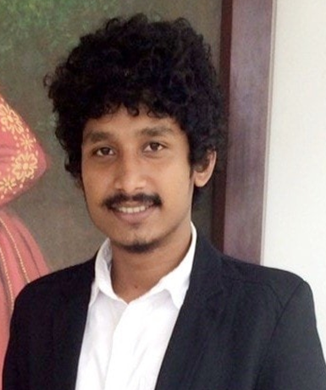
IT19981918 – A.M.N.D. Aththanayake Information Technology
IT19981918 | A.M.N.D. Aththanayake | 22_23-J 83
03/02/2023

Slide 44

Research Problem
Existing mobile apps for object detection for BVIs provide limited information about the captured objects, such as an alert sound. It is much needed to know what the app detected and how far is it located to be more prepare before an accident happens.
IT19981918 | A.M.N.D. Aththanayake | 22_23-J 83
03/02/2023

Slide 45
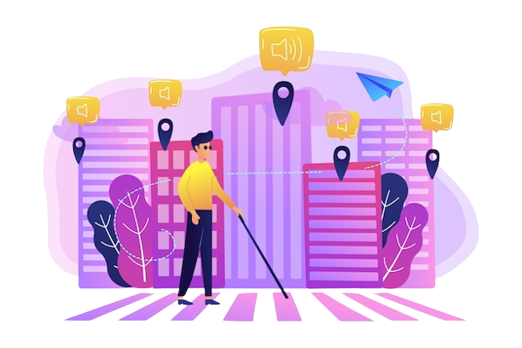
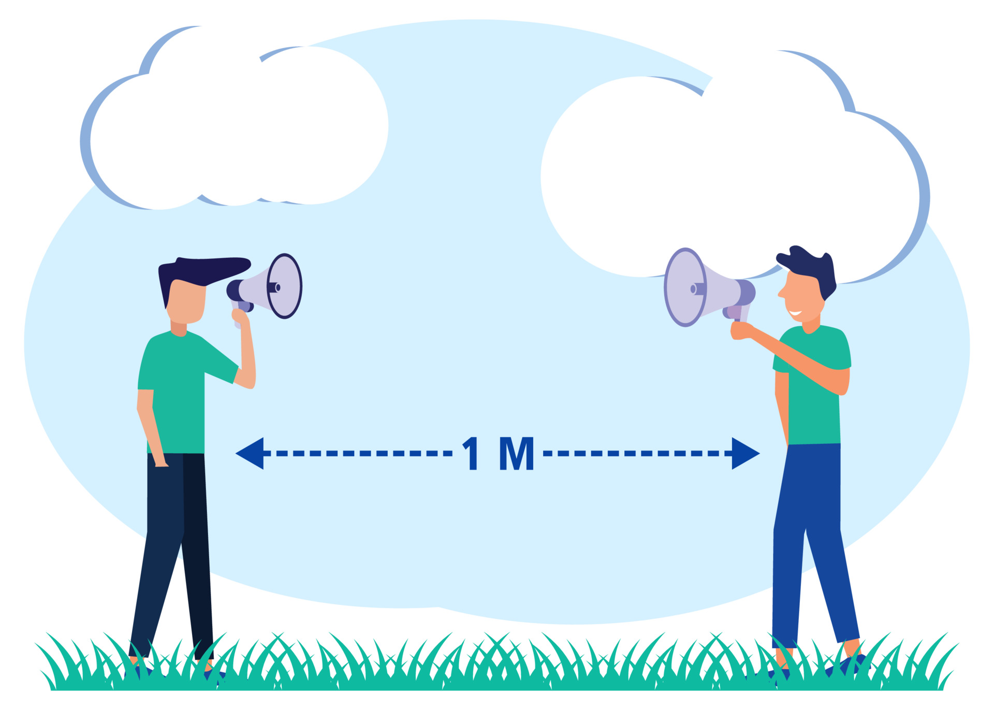
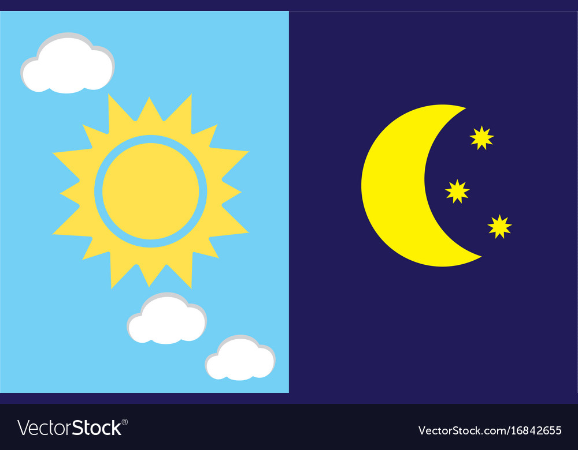
Proposed Solution
Implement object identifying when navigating through the journey to assist with obstacles as well as distances calculating to forecast collision detection.
Calculate distance between the user and obstacle.
Work properly in every background conditions.
Detect and recognize in a vary range of objects.
IT19981918 | A.M.N.D. Aththanayake | 22_23-J 83
03/02/2023

Slide 46
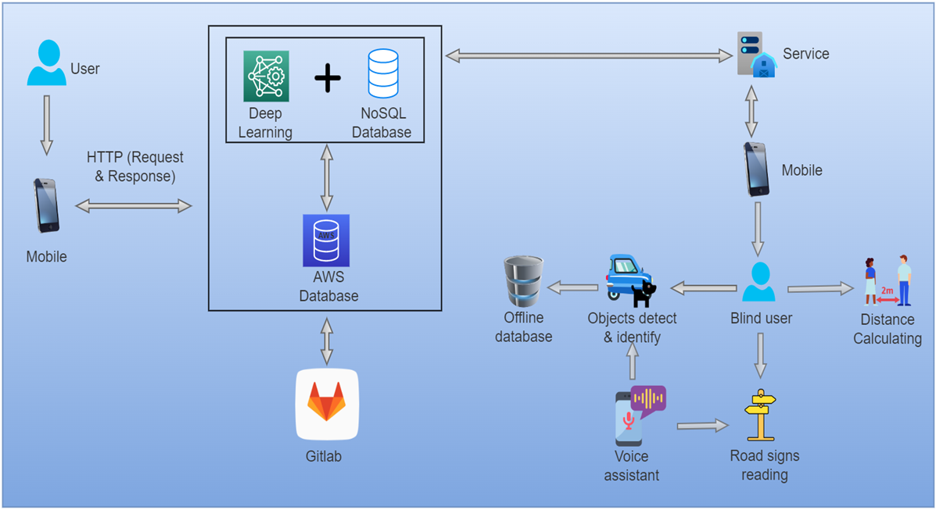
Component Overview Diagram
IT19981918 | A.M.N.D. Aththanayake | 22_23-J 83
03/02/2023

Slide 47
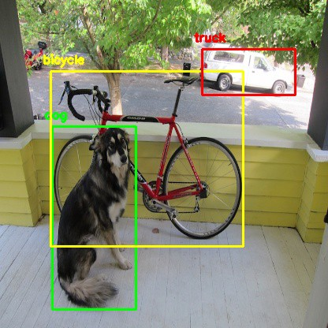
Current Progress 50%
Implemented a model to detect and identify objects with the accuracy value.
Implemented a formula using focal length and actual length to calculate the distance to a person, frame by frame with real time capturing.
The model has trained to identify vary range of objects.
IT19981918 | A.M.N.D. Aththanayake | 22_23-J 83
03/02/2023

Slide 48
Requirements
User Requirements
Users should be able to maintain trust in the accuracy of data.
The app should be supportive in both online and offline platforms.
Non-Functional Requirements
Availability
System Requirements
The system should be supportive according to the user’s demands and requests.
The app should be supportive to the user in identifying objects even in the dark.
The phone flasher should work properly when the background light is not enough to detect an object.
Smartphone should have at least a 20MP back camera which all of modern smartphone have these days.
Performance
Accuracy
Speed
IT19981918 | A.M.N.D. Aththanayake | 22_23-J 83
03/02/2023

Slide 49
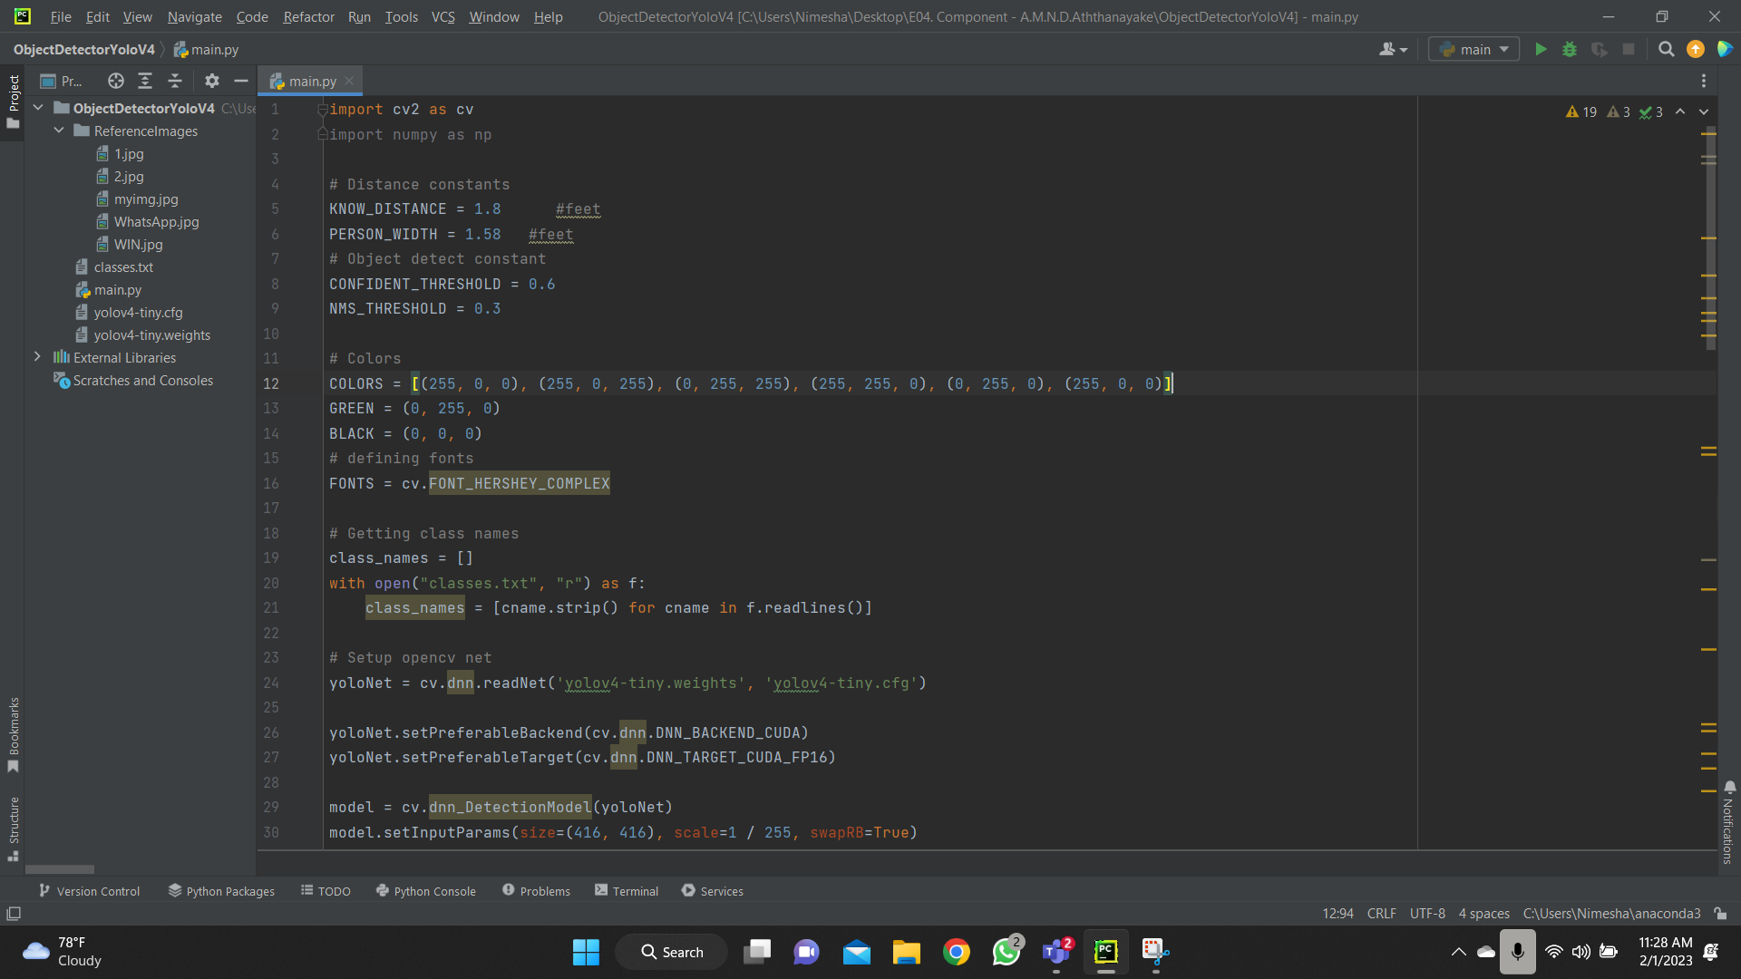
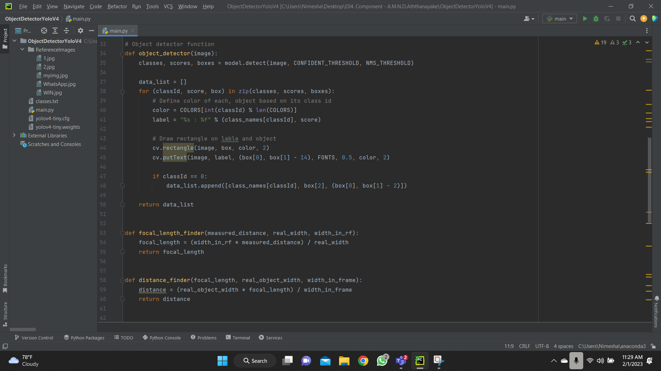
Proof Of Work
IT19981918 | A.M.N.D. Aththanayake | 22_23-J 83
03/02/2023

Slide 50


Proof Of Work
IT19981918 | A.M.N.D. Aththanayake | 22_23-J 83
03/02/2023

Slide 51



Proof Of Work
IT19981918 | A.M.N.D. Aththanayake | 22_23-J 83
03/02/2023

Slide 52


Next Expected Progress 100%
Implement formulas and calculations to calculate the distance for other objects.
Implement the model to detect objects even in low light conditions.
Instead of frame-by-frame distance capturing method, calculate the distance using a captured image after the voice command to reduce the complexity and increase the feasibility.
IT19981918 | A.M.N.D. Aththanayake | 22_23-J 83
03/02/2023

Slide 53


Tools & Technologies
YOLO4 / YOLO5
Transfer Learning
Multi class object detection
OpenCV
PyCharm
IT19981918 | A.M.N.D. Aththanayake | 22_23-J 83
03/02/2023

Slide 54

Risk Mitigation
Normally distance to an object can’t be calculated by trigonometry only using the camera lens. It needed external sensors or IoT devices.
So instead of the proposed trigonometric formula, had to use ‘Focal Length’ formula to calculate the distance considering the camera lens, and reflection of the object.
Calculation of the distance frame-by-frame can be endless loop to the voice assistant and also to the user.
So, the voice assistant should only work after the user requesting for distance to objects.
IT19981918 | A.M.N.D. Aththanayake | 22_23-J 83
03/02/2023

Slide 55
Milestones
Implemented the model and trained dataset for Ishihara test.
Implemented the intelligent chatbot.
In progress 90%
Implementing color filters according to Ishihara test results
Implementing the outdoor navigation component
To be completed 100%
Implement the connectivity between voice assistant and other components
Integrate the components.
Implemented the object detector and identifier.
Implemented the currency notes reader
Implementing the distance calculation for trained objects.
Implementing the real time text reader.
Design the user interfaces and finalize the mobile application.
Implementing the text to speech method of the voice assistant
Completed 50%
03/02/2023

Slide 56



Marketing Plan
Available features for the free version
Voice assistant-based map navigation, object detection and identification, text reading, currency notes identifier.
Ishihara test and available color filters for related diagnosis.
Premium version to activate new features - $14.99/mo
Bus and train schedules
Translate any language
Augmented Reality based color filters
Play store and Apple store
03/02/2023

Slide 57




Best Practices
03/02/2023

Slide 58




Best Practices
03/02/2023

Slide 59
References
https://www.educative.io/courses/build-your-own-chatbot-in-python/qAA5mKY19Gp
https://towardsdatascience.com/reading-color-blindness-charts-deep-learning-and-computer-vision-a8c824dd71cd
https://pyimagesearch.com/2017/09/11/object-detection-with-deep-learning-and-opencv/
https://datascienceparichay.com/article/distance-between-two-points-python/
https://phdservices.org/currency-recognition-using-opencv-python/
03/02/2023

Slide 60



Thank You !

